Slide 1
An investigation into the cost of male cardiac patients in Vermont
Uday Joshi
Data Science, General Assembly/Booz Allen Hamilton, Wave 3 Cohort

Slide 2
Agenda
Business Case and Objective
Data/EDA
Models
Results
Conclusion
Lessons Learned

Slide 3
Business Case & Objective
Heart failure (HF) is prevalent in 5.7 million people in the United States
Cost to treat HF per annum estimated to be between $37.2 and $39.2 billion
Reasons for cost include policy makers, and data issues
Discrepancies in pharmaceutical cost estimation
Medicare does not negotiate prices with hospitals
Private insurance companies negotiate prices with hospitals
Journal of the American Medical Association study
Study found that in 2016, the average cost of coronary artery graft surgery was $75,345 compared to $15,742 and $36,509 in the Netherlands and Switzerland
Objective
Determine the cost of cardiac procedures for males in Vermont
Stakeholders: Hospitals, insurance companies, local and federal government
Source: A Reevaluation of the Costs of Heart Failure and Its Implications for Allocation of Health Resources in the United States.
URL: https://onlinelibrary.wiley.com/doi/pdf/10.1002/clc.22260
Notes:
Ad project timeline to address why we are discussing this as a concept

Slide 4
Data
Data was collected from the Vermont Department of Health website
Data includes hospital inpatient discharges from 2011-2016 for Vermont hospitals
Data Input | Name | Description | Data Type
HNUM2 | HOSPITAL_NUMBER | HOSPITAL_NUMBER | integer
ATYPE | ADMISSION_TYPE | ADMISSION_TYPE | integer
ASOUR | ADMISSION_SOURCE | ADMISSION_SOURCE | integer
AGEGRP | AGE_GROUP | PATIENT AGE GROUP | integer
ZIPGRP | ZIP_CODE_GROUP | PATIENT ZIP CODE | text
SEX | SEX | SEX | integer
DSTAT | DISCHARGE_STATUS | DISCHARGE_STATUS | integer
PPAY | PRINCIPAL_PAYMENT_SOURCE | PRINCIPAL_PAYMENT_SOURCE | integer
CHRGS | TOTAL_CHARGES | TOTAL COST OF CARE | decimal
DRG | DRG | DIAGNOSIS RELATED GROUP (INPATIENT ONLY) | integer
PDAYS | PATIENT DAYS | (DISCHARGE DATE minus ADMISSION DATE) | integer
DY | YEAR OF DISCHARGE | PATIENT DISCHARGE YEAR | integer
ADMID_QTR | ADMID_QTR | ADMISSION QUARTER | integer
DISCD_QTR | DISCD_QTR | DISCHARGE QUARTER | integer

Slide 5
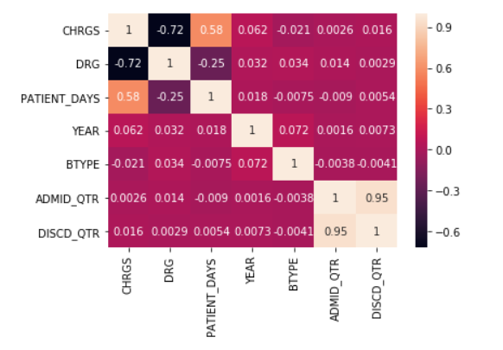
EDA – Correlation
Charges and Patient Days have the highest correlation

Slide 6

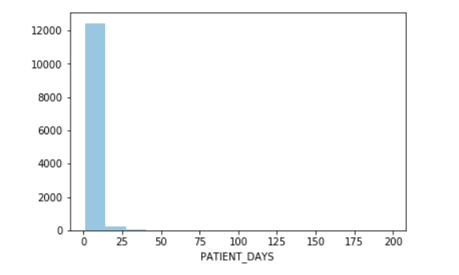
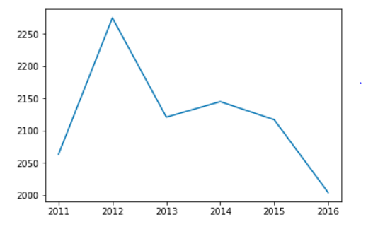
EDA – Patient Days
Male Cardiac Patient Days
Male Cardiac Patient Days by Year
Number of Patients
Number of Patients
Year
Mean = 4.13 Days

Slide 7
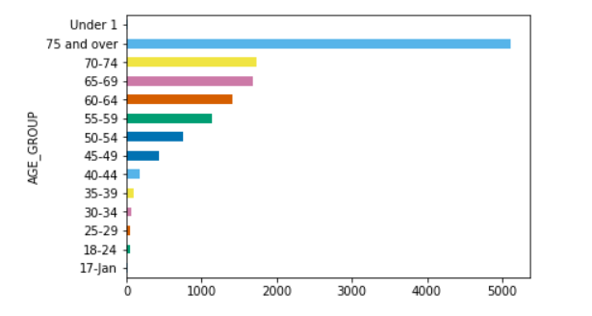
EDA – Age Group
Male Cardiac Age Groups
Male Cardiac Patient Days by Year
Age | Number of Cardiac Patients
75 and over | 5113
70-74 | 1737
65-69 | 1674
60-64 | 1409
55-59 | 1137
50-54 | 751
45-49 | 436
40-44 | 179
35-39 | 102
30-34 | 66
18-24 | 48
25-29 | 46
1-17 | 15
Under 1 | 12
Number of Patients
Most Frequent = 75 and Over (40% of Patients)

Slide 8
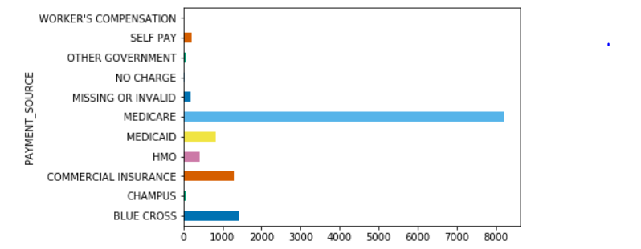
EDA – Payment Source
Male Cardiac Payment Sources
Number of Patients
Medicare = 64.5%

Slide 9
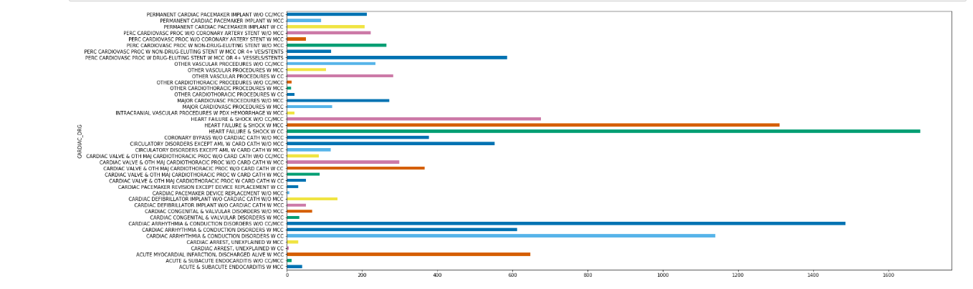
EDA – Cardiac DRG by Patient Days
Male Cardiac DRGs
Number of Patients
1. Heart Failure & Shock W CC
2. Heart Failure & Shock W MCC
3. Heart Failure & Shock W/O CC/MCC
W CC = With Complication or Comorbidity; W MCC = With Major Complication or Comorbidity

Slide 10
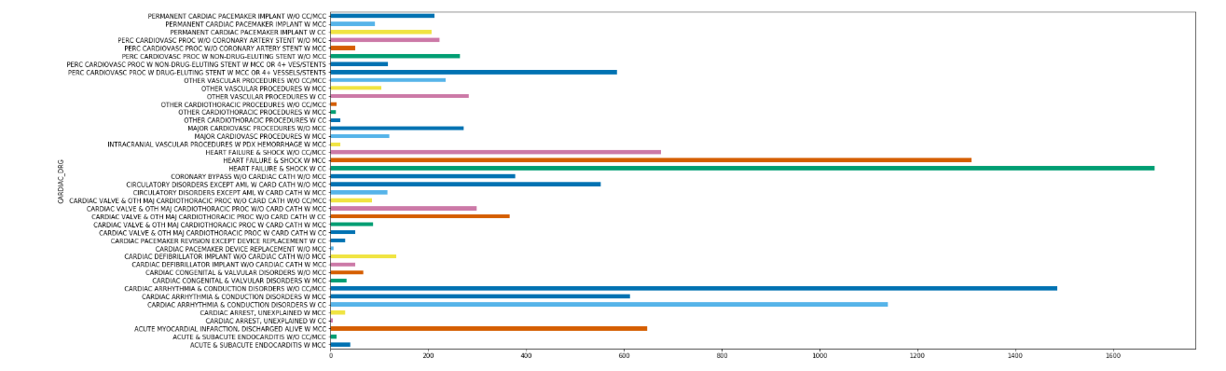
EDA – Cardiac DRG by Charges
Male Cardiac DRGs
Charges ($)
1. Heart Failure & Shock W CC
2. Cardiac Arrhythia & Conduction Disorders W/O MCC
3. Heart Failure & Shock W MCC
W CC = With Complication or Comorbidity; W MCC = With Major Complication or Comorbidity

Slide 11
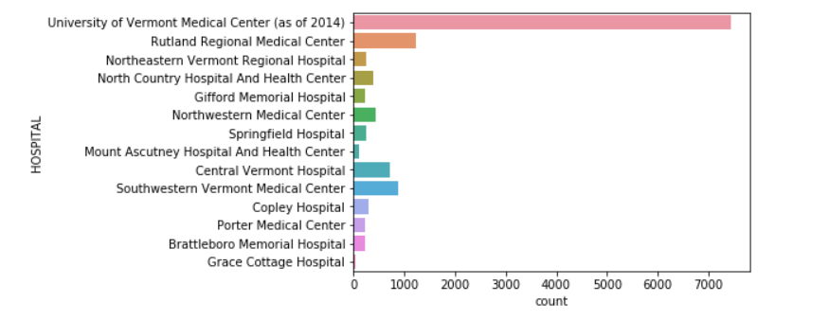
EDA – Hospitals by Cardiac Cases
Male Hospital Patients (2011-2016)
Top 5 Hospitals by volume (2011-2016)
Hospital | Cardiac Inpatients
University of Vermont Medical Center | 7450
Rutland Regional Medical Center | 1241
Southwestern Vermont Medical Center | 872
Central Vermont Hospital | 709
Northwestern Medical Center | 431
Number of Patients
Most Frequent = University of Vermont Medical Center (59% of Patients)

Slide 12
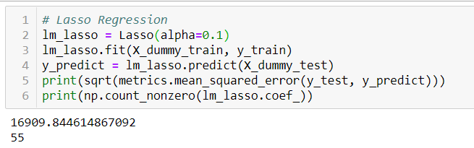
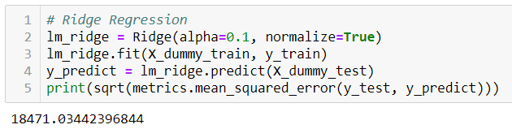
Models – Linear Regression (Lasso & Ridge)
Lasso Regression
Ridge Regression
Error = $16,910
Error = $18,471
Median of Charges = $19,532
Train, Test, Split (70/30) used
Dummy Variables used: 'HOSPITAL', 'ADMISSION_TYPE', 'ADMISSION_SOURCE','AGE_GROUP', 'ZIP_CODE', 'GENDER', 'DISCHARGE_STATUS', 'PAYMENT_SOURCE', 'DRG', 'CARDIAC_DRG', 'HOSPITAL_SERVICE_AREA'

Slide 13
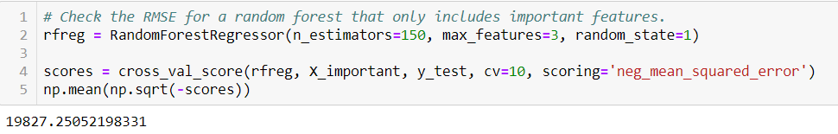
Model – Random Forest Regressor
Random Forest Regressor
Error = $19,827
Median of Charges = $19,532
Train, Test, Split (70/30) used
Dummy Variables used: 'HOSPITAL', 'ADMISSION_TYPE', 'ADMISSION_SOURCE','AGE_GROUP', 'ZIP_CODE', 'GENDER', 'DISCHARGE_STATUS', 'PAYMENT_SOURCE', 'DRG', 'CARDIAC_DRG', 'HOSPITAL_SERVICE_AREA'

Slide 14
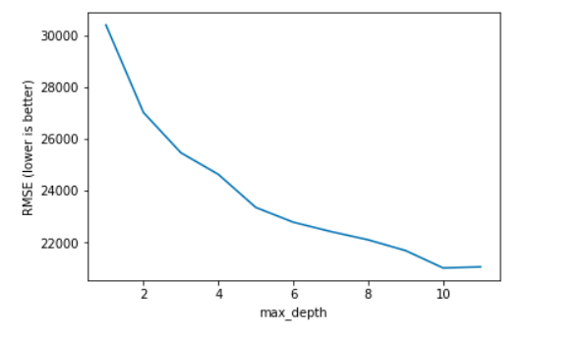
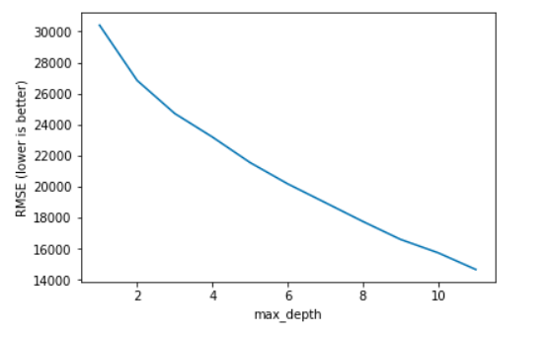
Model – Decision Tree
Test
Train
Trained model performs better
Dummy Variables used: 'HOSPITAL', 'ADMISSION_TYPE', 'ADMISSION_SOURCE','AGE_GROUP', 'ZIP_CODE', 'GENDER', 'DISCHARGE_STATUS', 'PAYMENT_SOURCE', 'DRG', 'CARDIAC_DRG', 'HOSPITAL_SERVICE_AREA'

Slide 15
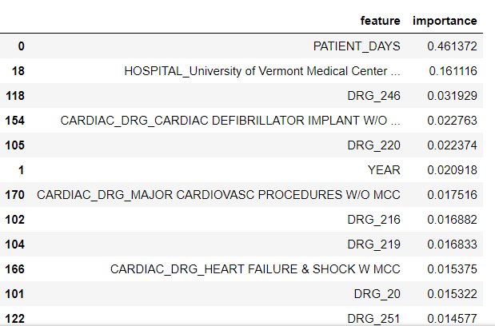
Model – Decision Tree (Gini)
Features Importance
Patient days has the greatest amount of importance
DRG 246 = PERC CARDIOVASC PROC W DRUG-ELUTING STENT W MCC OR 4+ VESSELS/STENTS
DRG 220 = CARDIAC VALVE & OTH MAJ CARDIOTHORACIC PROC W/O CARD CATH W CC

Slide 16
Conclusion
Models used:
Lasso Regression
Ridge Regression
Decision Trees
Random Forest
Lasso regression performed the best, and had the least error

Slide 17
Lessons Learned
Further investigation of Linear Regression (value in $T)
Comparison between male and females costs
Use classification to bucket charges into categories
Use smaller number of features – decision tree

